Slide 1
Visualizing Complex Data
N. D. Lewis

Slide 2
Explore similarity using trees
Hierarchical clustering is a group of statistical techniques that measure the similarity among a group of entities.
These methods start with the calculation of the distances of each entity from all the other entities in a dataset.
Groups or clusters are then formed usually by a process of agglomeration or division.

Slide 3
Explore similarity using trees
A dendrogram (from Greek Dendron meaning tree, and gramma meaning drawing) is a tree diagram used to display the groups formed by hierarchical clustering.
One of the major uses of dendrograms is to discern any subsets of observations whose members are both close to one another and/ or isolated from the rest.
This ability has proved extremely useful in fields ranging from marketing and fake software detection to understanding genetic diversity in agricultural crops.

Slide 4
Explore similarity using trees
Variants of dendrograms include:
  cladograms,
  fan trees,
  unrooted trees &
  radial trees

Slide 5
Treemaps
Treemaps display hierarchical (tree-structured) data in a colored mosaic form containing embedded, rectangular shapes.
In a treemap the branch of tree structured data is given a rectangle, which is then tiled with smaller rectangles representing sub-branches or end leaves.
A leaf node's rectangle has an area proportional to a specified dimension of the data.

Slide 6
Treemaps
The color and size dimensions of the rectangles allow for the identification of patterns that might be difficult to spot using standard bar charts and graphs.
A key advantage of using treemaps for large datasets is that they can legibly display thousands of items simultaneously.
The treemap partitions the image into a collection of box-shaped elements, forming a mosaic.

Slide 7
Treemaps
Example: treemap for the Dow Jones Industrial Average (as of end of Jan 2005)
data is represented as eight large rectangular regions; one each for each of eight categories making up the DJIA.
Each inner box represents an individual stock (of which there are thirty in the index) and is sized according its price.

Slide 8
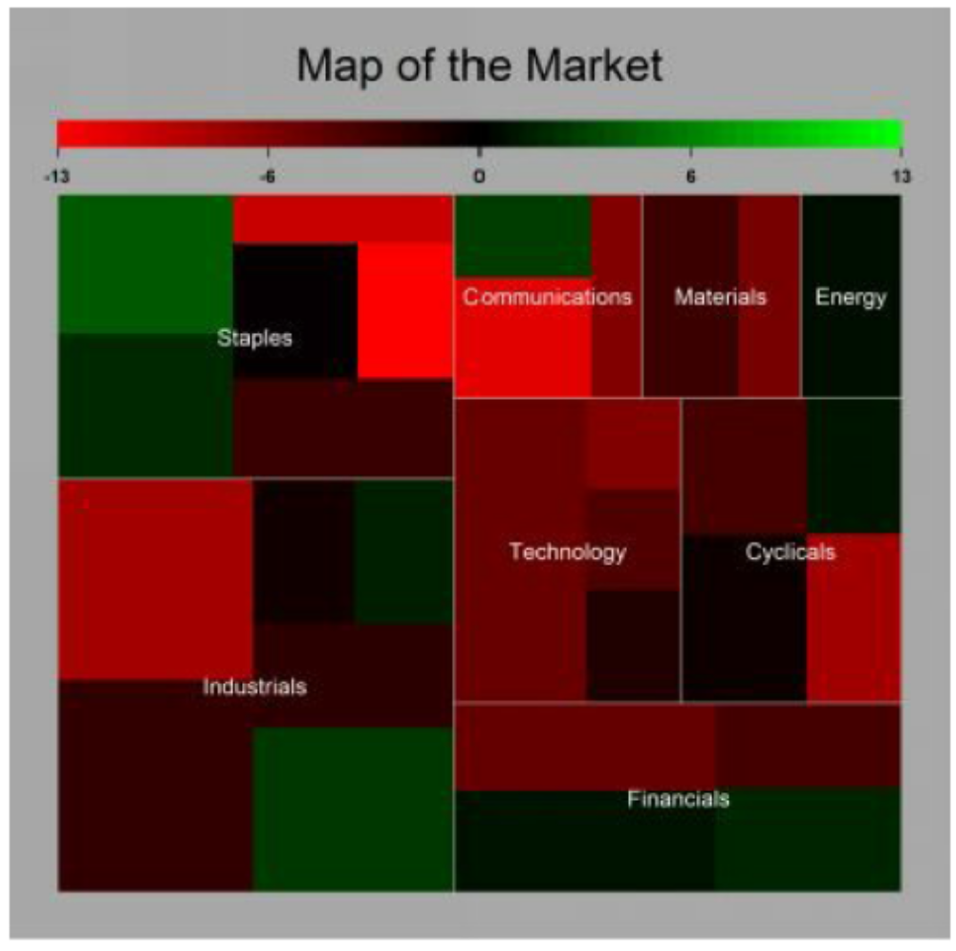
Treemap of Dow-Jones Index as at the end of January 2005
Notes:
Financials consists of four stocks and are represented by four colored rectangular boxes, each with a shading based on the price return for January 2005.
Price returns are represented using a red through green scale; the higher the return the greener the box.
the hierarchy of the Dow Jones Industrial Average can be
easily seen; as can the relative number of stocks for each sector. The dominant
sectors and stocks in terms of price can be quickly identified by the size of
rectangle. As can the relative performance of each sector and individual stock.

Slide 9
Treemaps
The ability to represent a hierarchy of data makes the treemap visualization both efficient and effective.
Originally, it was designed to visualize file space on very large computer-storage disk devices, treemaps are now used in a diverse range of fields including human-gene research, social network analysis and finance.

Slide 10
Variants of the Rose Diagram

Slide 11
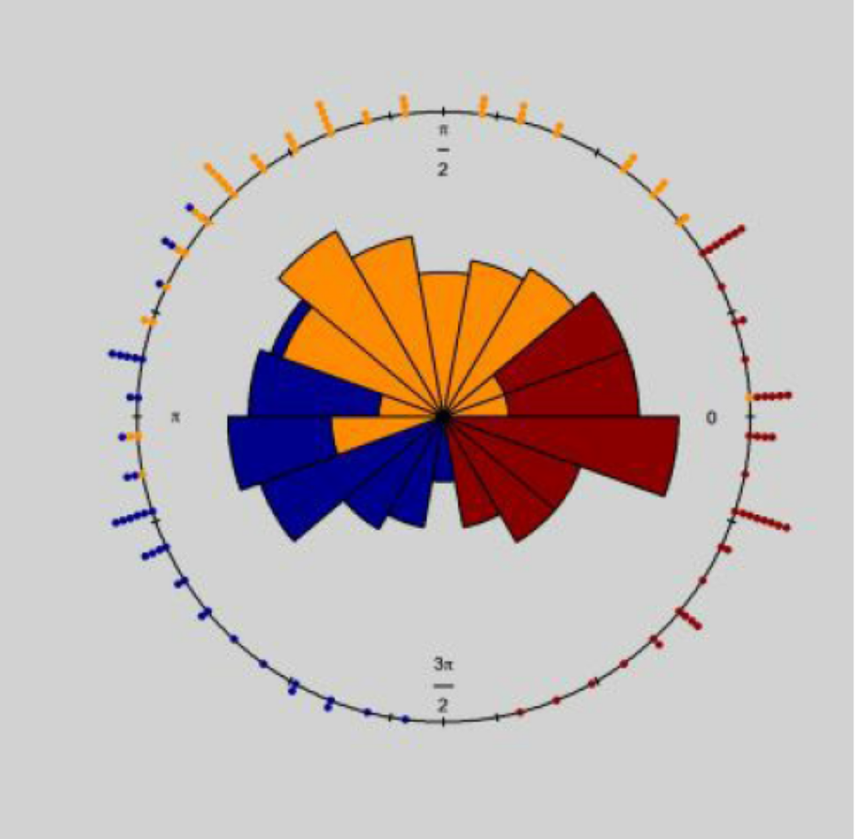
Foraging direction of three beavers
Lewis, N.D. (2013). The Visual Display of Quantitative Data. Heather Hills Press.
Notes:
Each beaver is represented by a different color (orange, red, blue). The foraging directional preferences of each beaver are clearly discernible from the diagram.

Slide 12
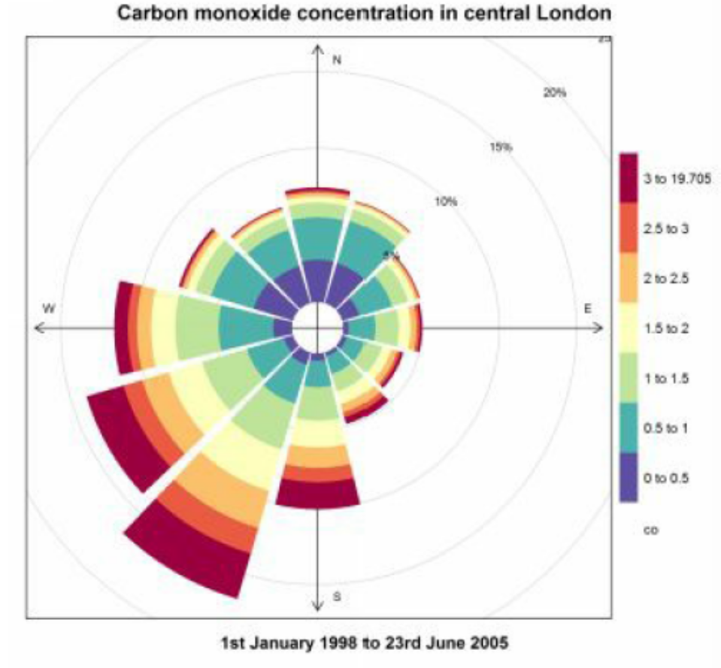
Pollution Rose
Notes:
It plots the frequency of counts by wind direction for carbon monoxide concentration (parts per million) measured at Marylebone in central
London. The petals are similar to the bars in a histogram and represent the
frequency of observations. In this image the petals are color coded to capture
the extent of concentration. Circular bands are drawn at 5%,10%,15% and
20%. A petal that touches the 5% band represents 5% of the overall number of observations.

Slide 13
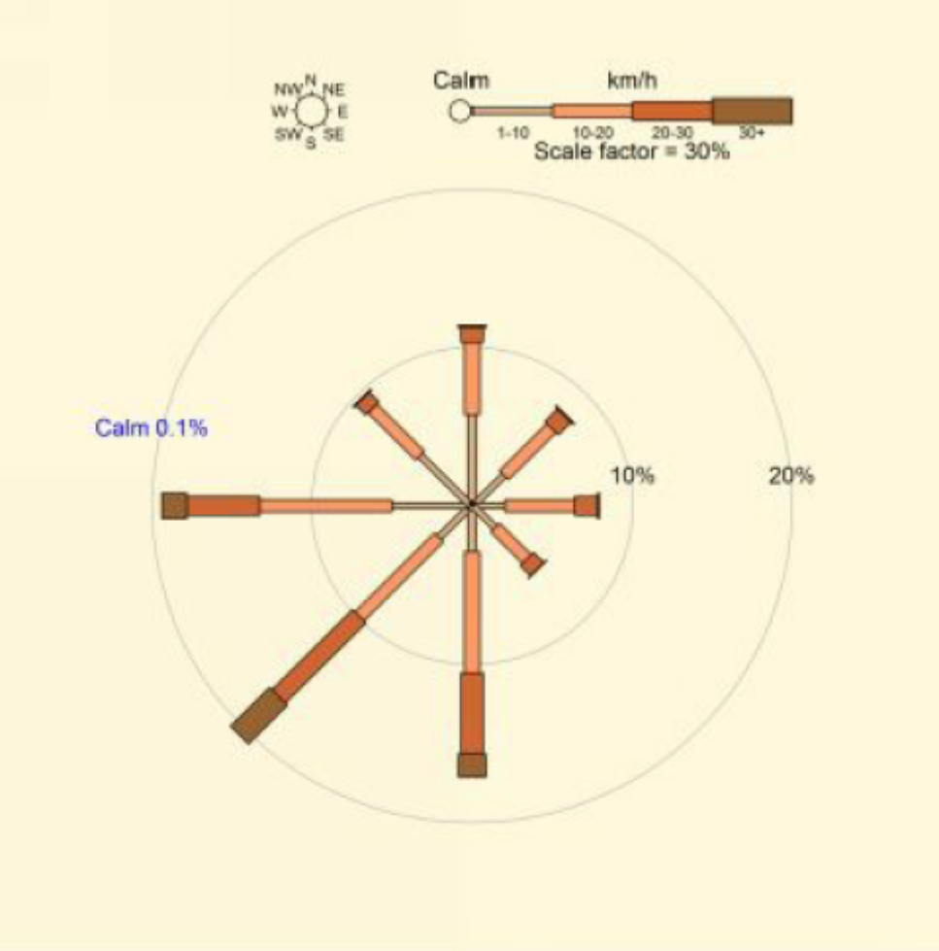
Australian Wind Rose
Notes:
data
measured at Marylebone, London between 1st January 1998 to 23rd June 2005.
Wind directions are divided into eight compass directions. The circles around the image represent the various percentages of occurrence of the winds. For example, the branch to the north west just reaches the 10% ring implying a frequency of 10% blowing from that direction. Calm has no direction.

Slide 14
Visualizing trends in multivariate timeseries data
Multivariate shaded timeseries plots allow easy identification of relationships
between numerous variables and trends in those variables individually and
simultaneously across time.

Slide 15
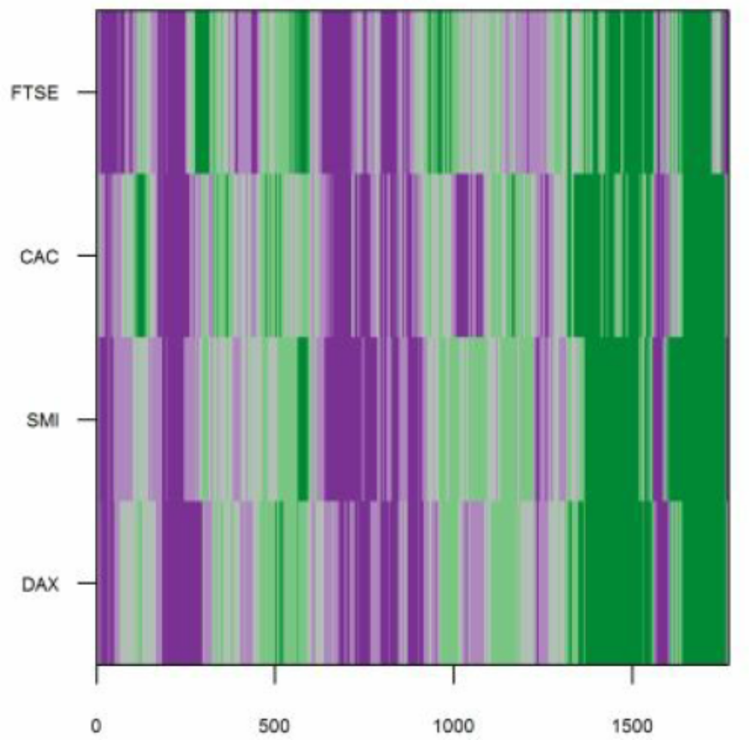
Multivariate shaded timeseries plot of European stock markets
Notes:
plot for the 90 day change in stock prices for four European stock market indices (FTSE,CAC, SMI and DAX) using data collected over the period 1991-1998. Notice how the shading of colors ranges from dark purple for negative 90 changes in price, to deep green for very positive changes in price. Observe also how the image allows you to identify the trend in price changes across time and also between stock markets. In this way the multivariate shaded timeseries plot maximizes the visibility of any trends within the sample data.

Slide 16
One of the major uses of a multivariate shaded timeseries plot is to visualize trends between and within variables across time.
This is an extremely useful property for exploratory data analysis of datasets which contain large numbers of timeseries data.

Slide 17
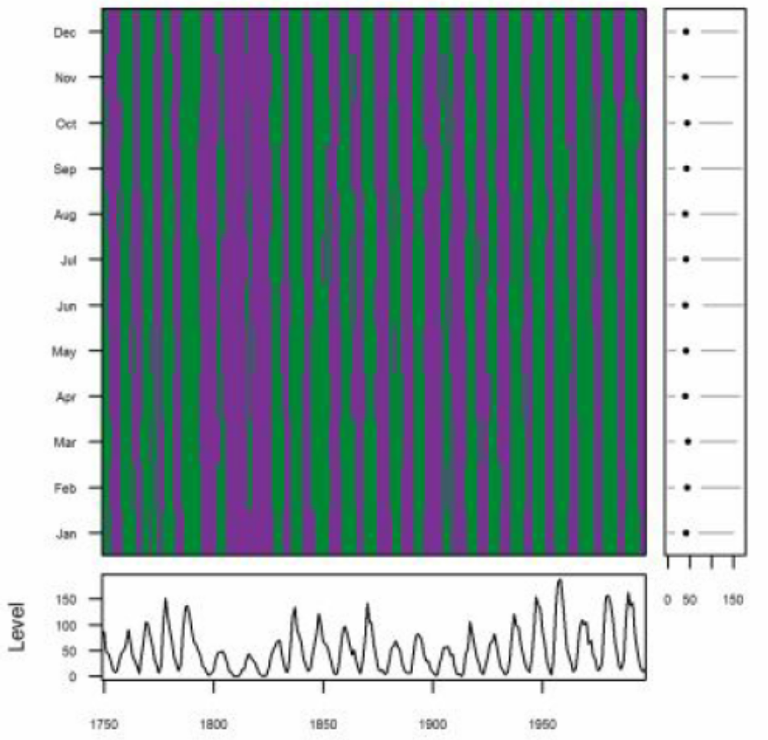
Notes:
The chart is constructed from data on the monthly number of sunspots recorded over the period 1749 to 1997. The main panel shows the time series of sunspots for each month of the year. The values of each time series are discretized and assigned to distinct categories. The shading represents whether a high number (green) or low number (purple) of sunspots were recorded. The right panel contains box plots for each of the twelve months. The median value is represented by a large dot. The lower panel presents a time series plot of the median value of observations for each year.

Slide 18
Wordcloud

Slide 19
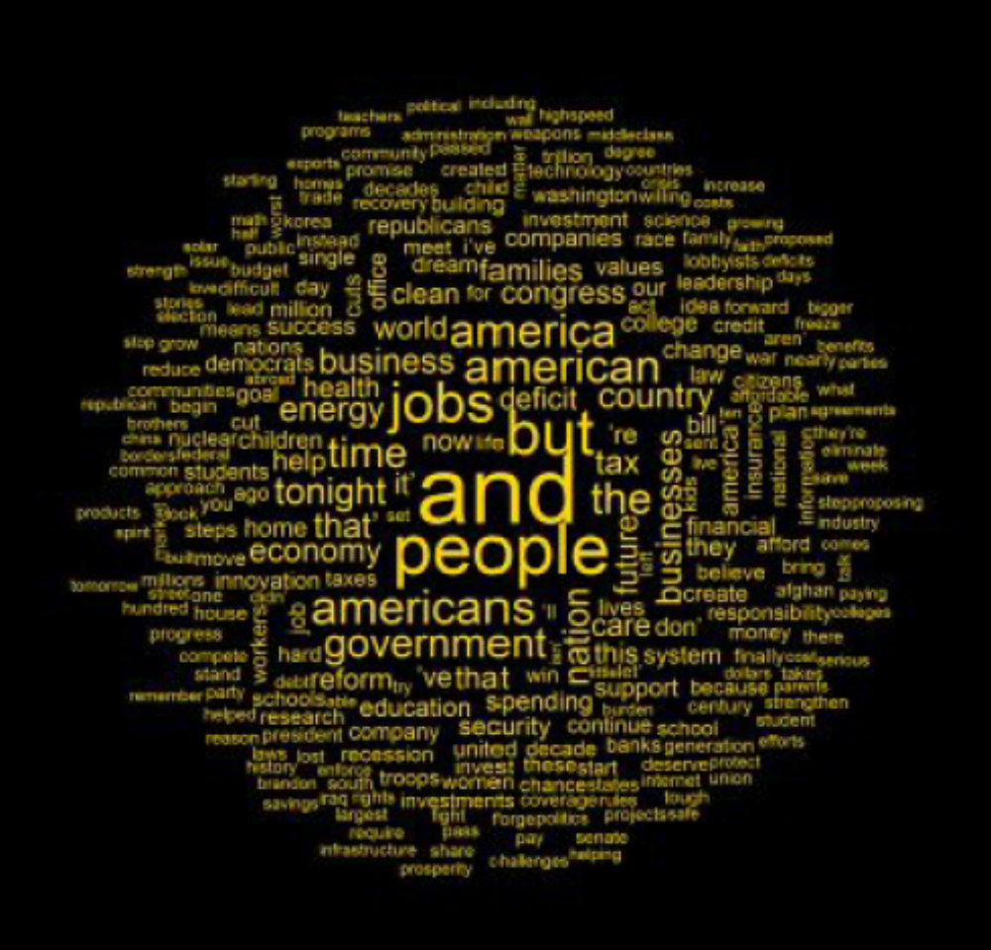
Notes:
The image displays the most frequently used words by President Obama in his
State of the Union addresses during 2010 and 2011. Word frequency is visualized by the size of the text; the more frequent the word the larger it appears in the image.

Slide 20
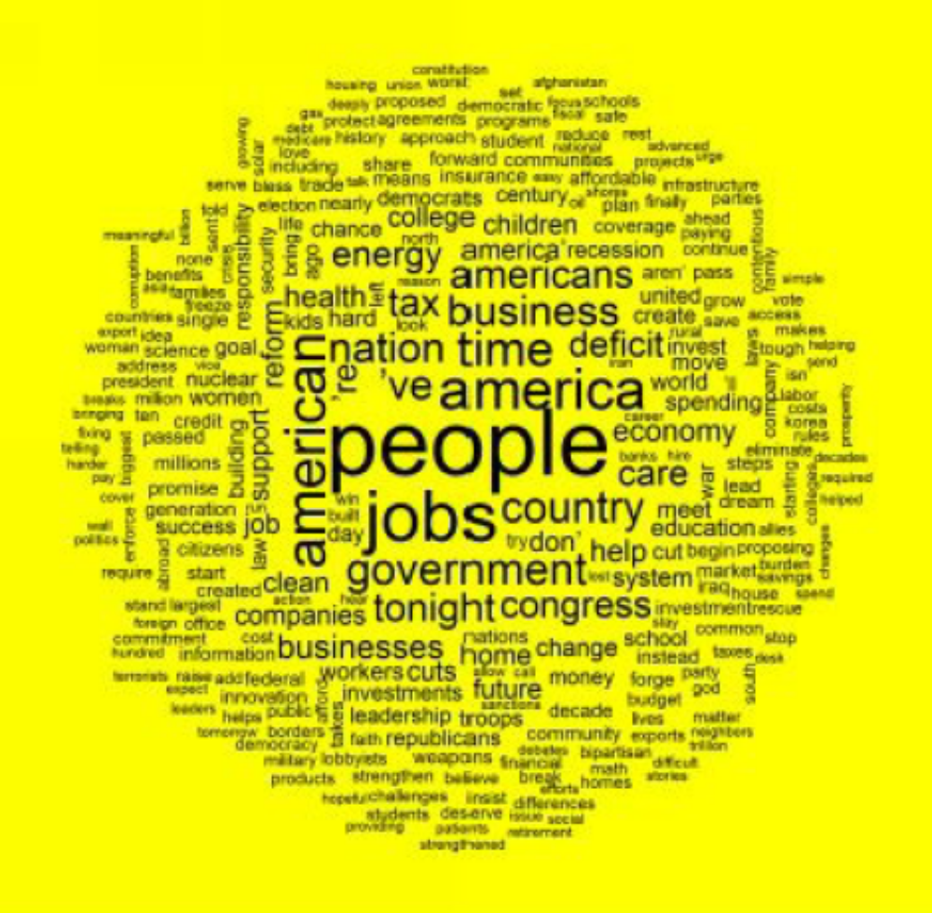
Commonality word cloud
Notes:
The image displays high frequently commonality words used by President
Obama in his State of the Union addresses during 2010 and 2011. Word
commonality is visualized by the size of the text; the greater the commonality of
a word the larger it appears in the image.

Slide 21
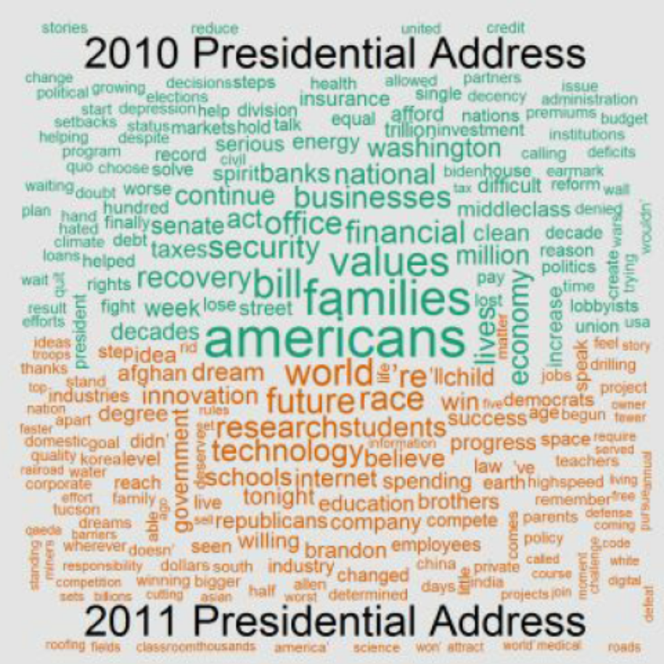
Comparison word cloud
Notes:
The image displays high frequently words used by President Obama in his State
of the Union addresses during 2010 and 2011. The top half of the diagram are
frequently used word from the 2010 address (green), the bottom half are high
frequency words from the 2011 address (burnt orange).

Slide 22
Next Topic:
Network Data

